Slide 1
Driven Car Pricing Classification
KDDM CS 513 - C
Final Project Presentation

Slide 2
INDEX
Problem Statement
Data Insights
Data Preprocessing
Feature Selection
Model Selection Criteria
Model Development
Future Aspects

Slide 3
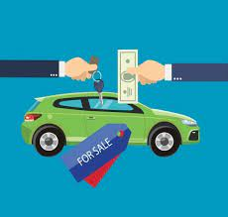
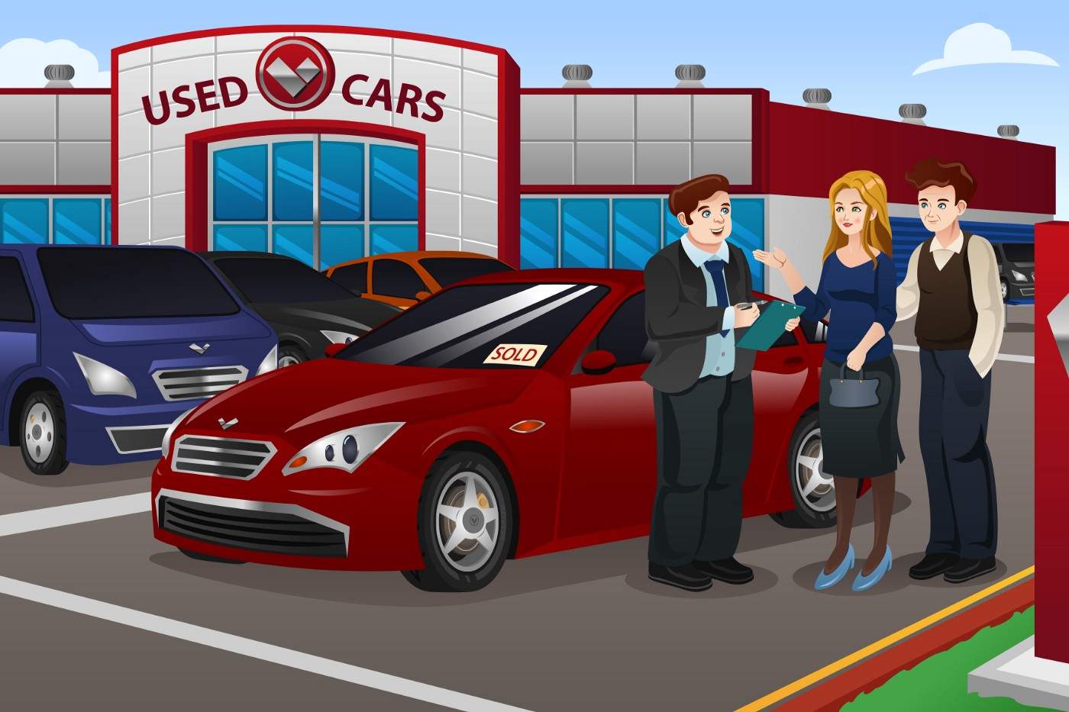
Problem Statement
People experience a hard row to hoe in purchasing desired featured second-hand car within the targeted budget and they play it by ear multiple times.
It is hard to decide whether used car is fraudulent or not?
Before helping people, it is important to analyze and validate our intuitions which can be possible by collecting experiences from people.
Here, We have applied our gained knowledge from this subject on one of the Kaggle Dataset.
Link: https://www.kaggle.com/datasets/gagasrock/car-quality-prediction

Slide 4
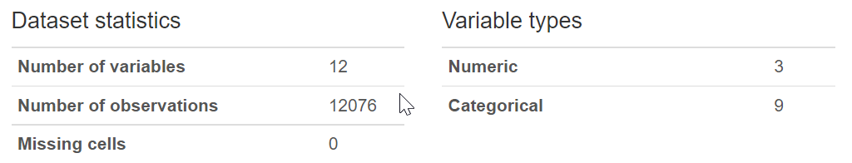
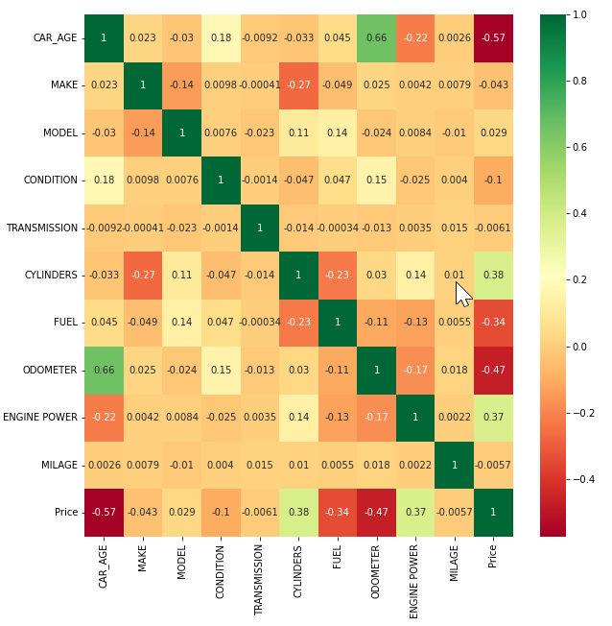
Data Insights
This data was collected manually from observations to build machine-learning models to predict the quality of the car.
A Rule of thumb is that customers aim to buy a low to average-priced car having desired features they have slept on for nights.
Target values are in terms of price represented as cheap(0), average(1), or high(2).
It had no missing values but a lot of noisy data which requires good observation and evaluating skills to decide whether to delete or include.
Odometer : between 0 to 469000
Year: between 1927 to 2020
Make: 39 companies car data
Model: each companies models

Slide 5
Data Insights
Low
Medium
High
<10
>=10 & <20
>=20 & <30
>30
Low CC
Avg CC
High CC
Petrol
Gas
4
6
8
Automatic
Manual
Excellent
Salvage

Slide 6
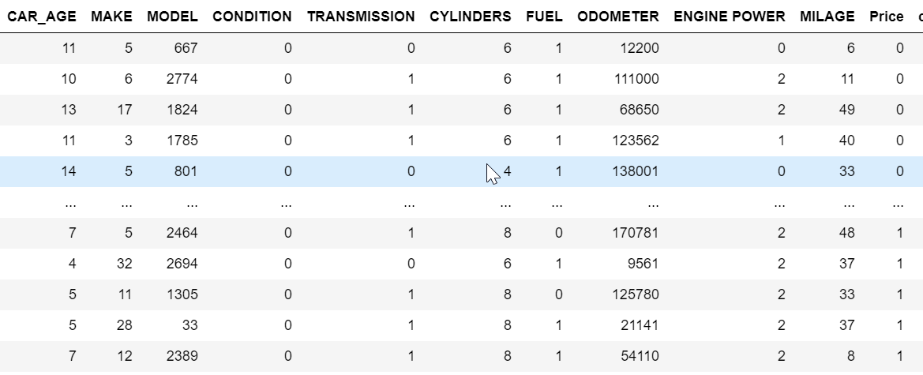
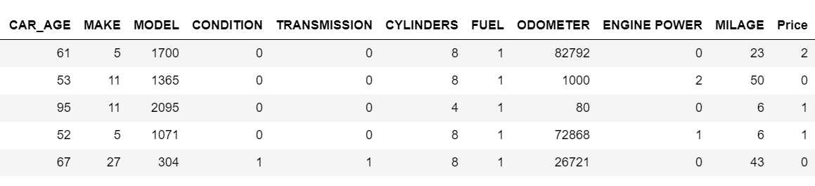
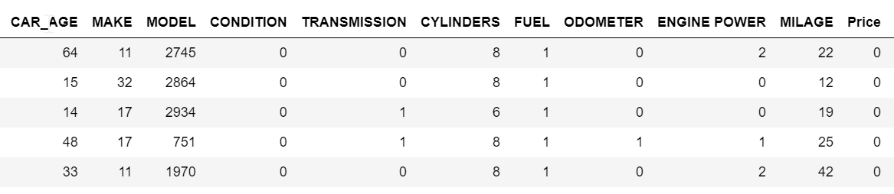
Data Preprocessing
Encoded Categorical values
Removed data large car age
Deleted Unreasoning Rows
Removed data with >2 age and odometer <100

Slide 7
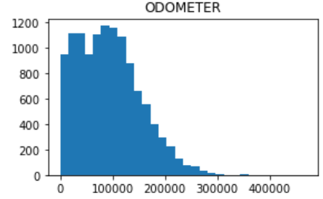
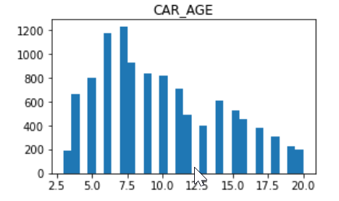
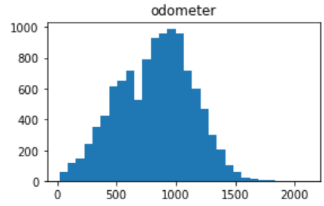
Data Preprocessing
Extracted Car Age
Deleted Unreasoning Rows
Normalized skewed data
Note: Fair Skew Values are between -0.5 to 0.5

Slide 8
Feature Selection
Used Random forest algorithm and computed Feature Importance as it has many advantages:
Feature importance are computed as the mean ,standard deviation or permutation of accumulation of the impurity decrease within each tree.
Impurity-based feature importance can be misleading for high cardinality features (many unique values).
Feature selection methods can be used in data pre-processing to achieve efficient data reduction. This is useful for finding accurate data models.
It is desirable to reduce the number of input variables to both reduce the computational cost of modeling and, in some cases, to improve the performance of the model.
the execution time of the classifier that processes the data reduces, also accuracy increases because irrelevant features can include noisy data affecting the classification accuracy negatively

Slide 9
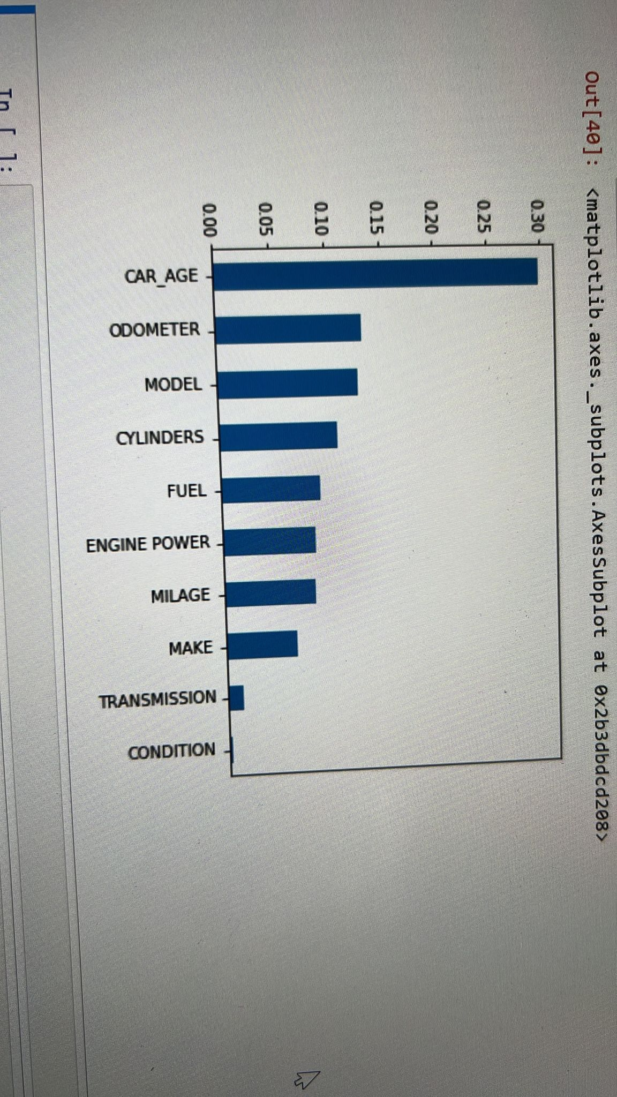
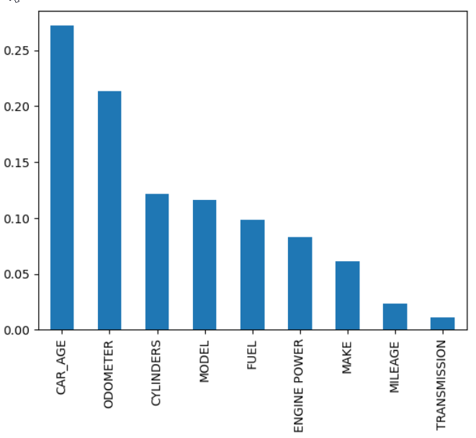
Feature Selection
Here, Condition Feature is independent of the given data.
Secondly, Odometer with skew data
Here, Condition Feature is dropped.
Odometer is having normalized values.

Slide 10
Model Selection Criteria
Confusion Matrix
Model Selection Factors
TN | FP | TN
FN | TP | FN
TN | FP | TN
F1-Score: harmonic mean of recall and precision
2(recall * Precision)
1
Precision * Recall
Recall:
TP
Precision: TN
TP + TN
TP + FP
Precision Recall Curve:
The precision-recall curve shows the tradeoff between precision and recall for different threshold.
A high area under the curve represents both high recall and high precision.

Slide 11
Model Development
K Neareast Neighbors:
KNN helps to classify the new data points based on the similarity measure of the earlier stored data points.
It can be developed for multiclass classifying dataset with comparative accuracy and precision.
It is lazy learner which uses data with several classes to predict the classification of the new sample point.
KNN is one of the simplest machine learning algorithms.
Why is KNN a non-parametric Algorithm?
The model parameters grow with the training data by considering each training case as a parameter model.
It is suitable for the dependent variable having continuous values against target variable.

Slide 12
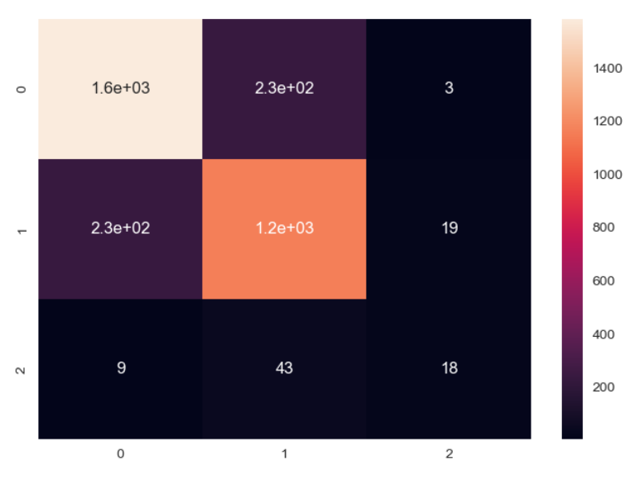
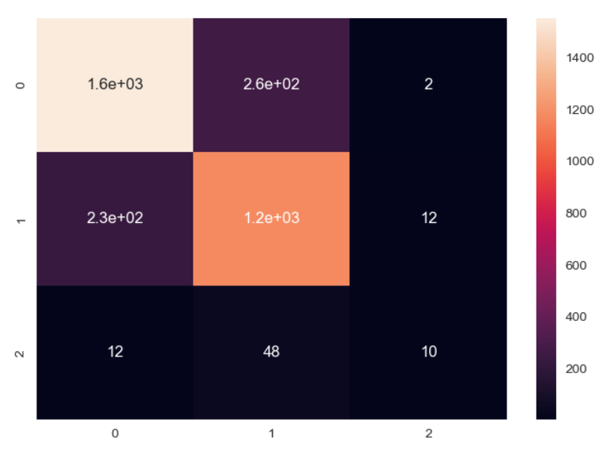
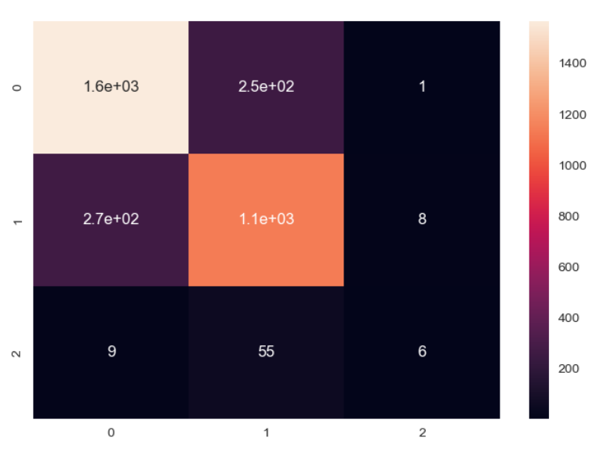
Model Development
K Neareast Neighbors:
Applied for, K = 3, 5 , 10
K = 3 has feasible accuracy and precision compare to other K values

Slide 13
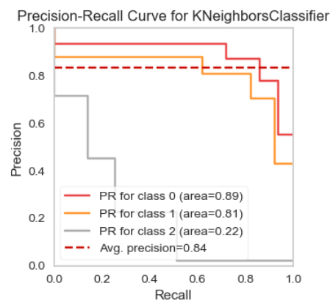
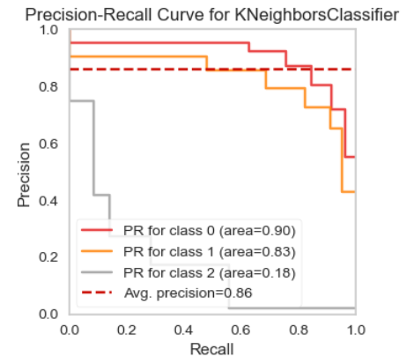
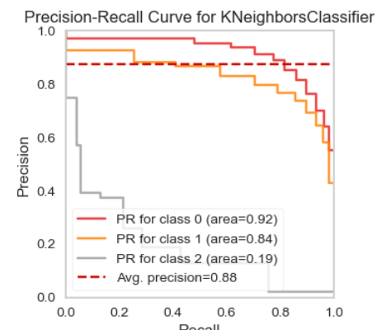
Model Development
K Neareast Neighbors:
Applied for, K = 3, 5 , 10
K = 3 has feasible accuracy and precision compare to other K values

Slide 14
Model Development
Decision Tree:
Easy visualize the prediction process in the flow chart format.
Decision trees do not require feature scaling
Decision trees handle categorical features in the raw text format.
While most models will suffer from missing values, decision trees are okay with them.
Trees can provide the feature importance or how much each feature contributed to the model training results.
It is suitable for simple data structure but will most of time overfit the data (If data is complex).

Slide 15
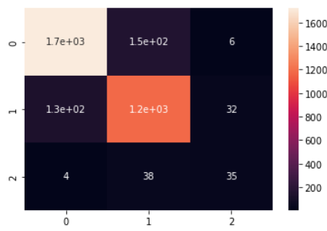
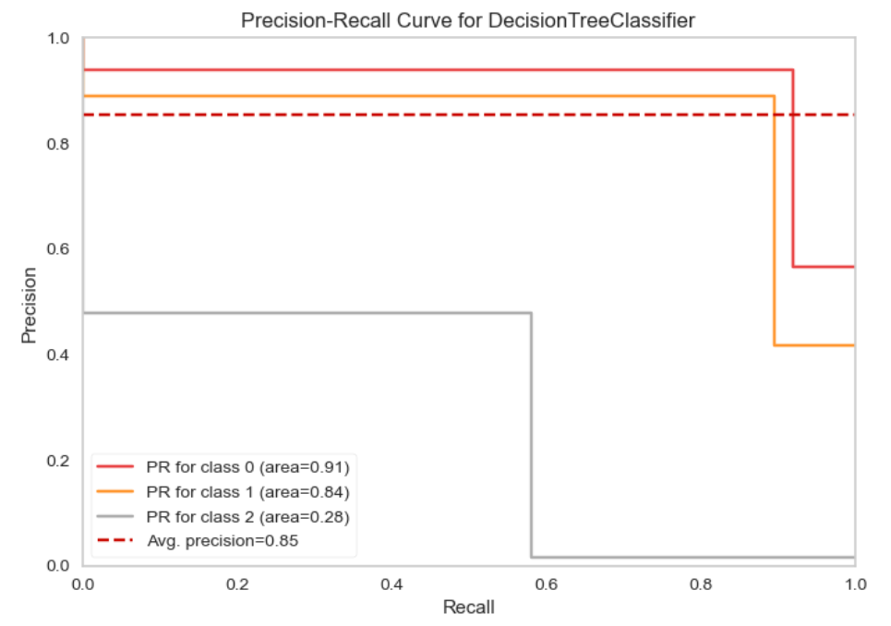
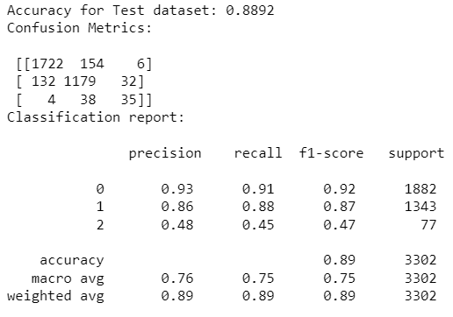
Model Development
Decision Tree: Outcomes

Slide 16
Model Development
CAT BOOST CLASSIFIER:
CatBoost is based on gradient boosted decision trees. During training, a set of decision trees is built consecutively. Each successive tree is built with reduced loss compared to the previous trees.
Fast training speed.
It can handle Categorical data very smoothly.
Good performance on large datasets
Ability to handle missing values
Ability to work with features that have different scales
It is only used for evaluating the quality of training (it is not used for training)
Remember: It is one of the best way to build Price Model Quality.

Slide 17
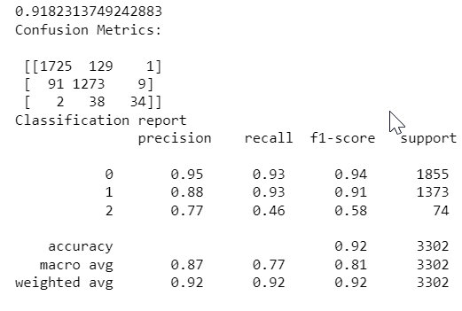
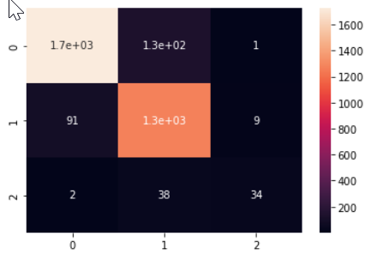
Model Development
CAT BOOST CLASSIFIER: OUTCOMES

Slide 18
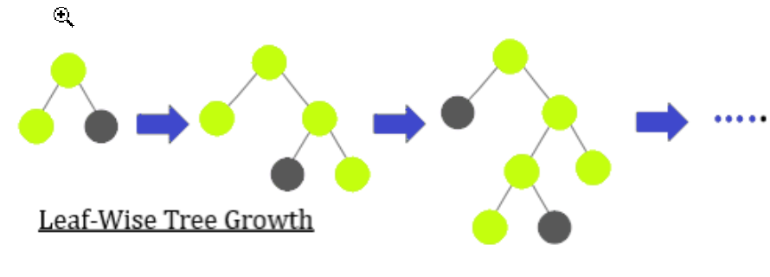
Model Development
Light GBM grows tree vertically while other algorithm grows trees horizontally meaning that Light GBM grows tree leaf-wise while another algorithm grows level-wise.
Light Gradient BOOSTING CLASSIFIER:
Faster training speed and higher efficiency
Reduce memory usage
one of the fastest and most accurate libraries for regression tasks
Multiclass Classifying data
Provide high-performance gradient boosting framework that uses a tree-based learning algorithm
Gradient-Based One-Side sampling (GOSS) and Exclusive Feature Bundling (EFB).

Slide 19
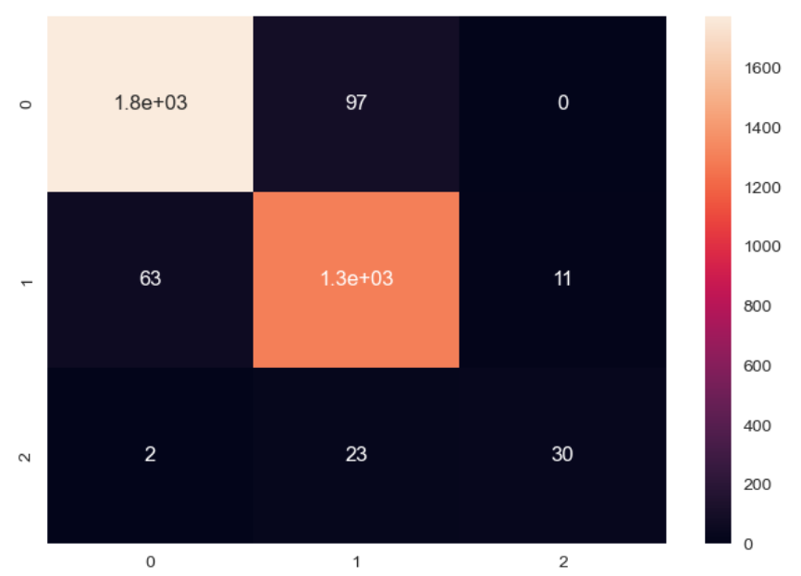
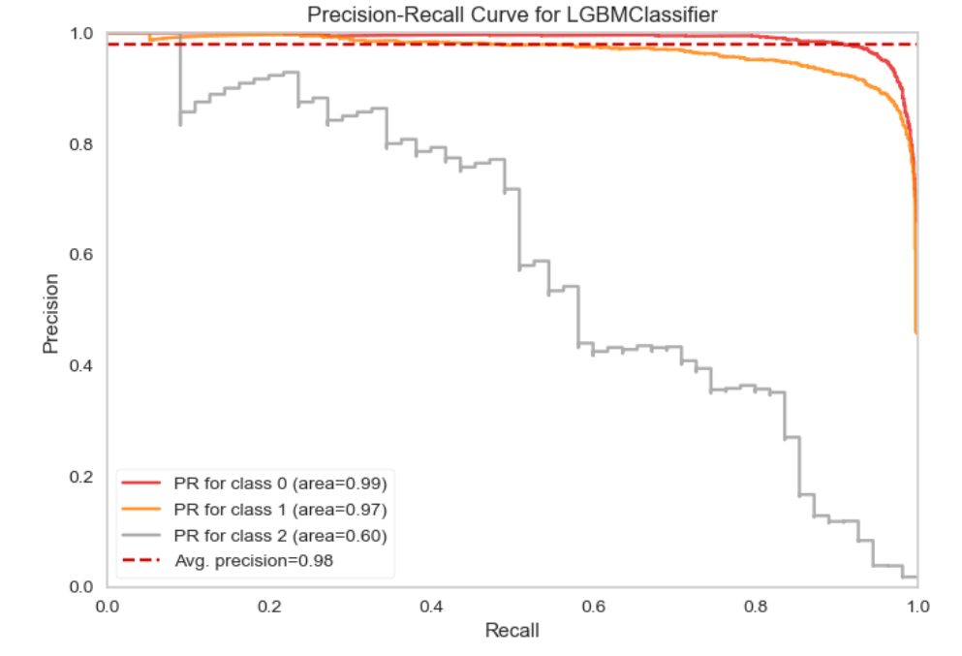
Model Development
Light Gradient BOOSTING CLASSIFIER: Outcomes

Slide 20
Future Aspects
For better performance, We planned to implement deep learning network logic
Use different adaptive learning rates a
Train on clusters of data rather than the whole dataset.
We also planned to create user friendly environment to learn and get skilled.
There has been an increasing demand of second-hand at places where immigrants and tourists stays and commute everyday.

Slide 21
Thank You
A special Thanks to Professor for this opportunity.

